Slide 1
No-Code SharePoint Magic
Transform Lists with Ready-Made JSON from the PnP Community
Douglas Spicer
SharePoint Administrator & Developer • Dan Solutions
sharepointindepth.com

Slide 2


https://www.collabsummit.org/
Upcoming SharePoint Conference
INTRO
SharePoint-a-Looza became the…
North American Collaboration Summit
Held in Branson, Missouri
Oct 4-6, 2026
Access over 60 sessions covering Microsoft 365, Teams, Viva, Copilot, Power Platform, Azure, and much more, along with our legendary attendee appreciation event, daily chances to win big prizes, and tons of awesome swag. Add a workshop at checkout for even more in-depth learning opportunities. 12 to choose from.
https://www.collabsummit.org/
SharePoint in Depth • No-Code SharePoint Magic
2

Slide 3


About Doug
INTRO
• SharePoint Administrator & Developer at Dan Solutions
• Over 15 years of SharePoint administration, development, governance, and migration experience
• Producer of SharePoint in Depth — practical notes and solutions from real-world SharePoint work https://www.SharePointinDepth.com
SharePoint in Depth • No-Code SharePoint Magic
2

Slide 4

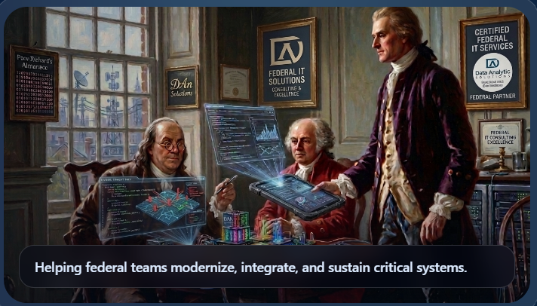
About DAn Solutions
INTRO
DAn Solutions delivers development, engineering, and enterprise integration services to:
  National security
  Homeland security
  Defense
  and federal agencies
We are engineers, analysts, knowledge managers, cyber practitioners, and delivery leaders with experience in classified, high-side, and enterprise environments.
www.dansolutions.com
SharePoint in Depth • No-Code SharePoint Magic
2

Slide 5
First Trick: Format a Column with Pills
COLUMN
Microsoft Lists | Project Tracker
{
"elmType": "div",
"attributes": {
"class": "sp-field-severity--good"
},
"txtContent": "@currentField"
}
Title
Owner
Status
Due
Intranet Refresh
Alex
In progress
Aug 12
HR Policy Review
Priya
Blocked
Aug 13
Facilities Move
Jordan
Complete
Aug 14
• Use the built-in formatting designer first
• Switch to Advanced Mode to see the JSON it generated
SharePoint in Depth • No-Code SharePoint Magic
4

Slide 6
The Generic List Form
FORMS
New item
• Visually generic
• All fields are full-width
• Not organized, just linear
Title
Enter a title
Department
Select an option
Owner
Enter a name
Status
Select an option
SharePoint in Depth • No-Code SharePoint Magic
5

Slide 7
Form JSON: Header + Body + Footer
FORMS
HEADER
{
"sections": [
{"displayname": "Details",
"fields": ["Title","Department","Email"]},
{"displayname": "Application",
"fields": ["Approver","Reviewer"]}
]
}
Branding, context, instructions
BODY
Sections and field organization
FOOTER
Actions, links, supplemental information
Body formatting organizes fields into sections
Form configuration changes display only - it does not alter list item data
SharePoint in Depth • No-Code SharePoint Magic
6

Slide 8
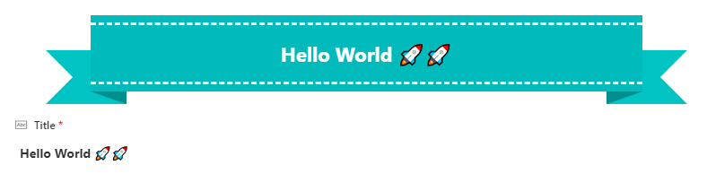
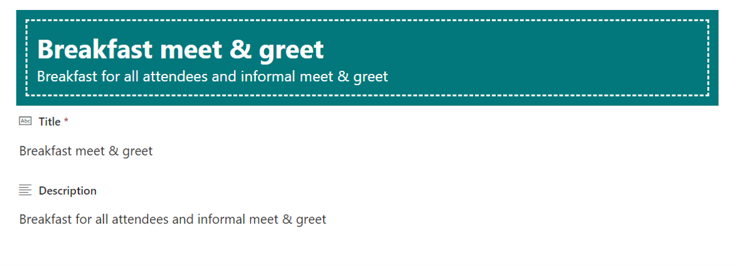
Ready-Made Form Samples from PnP
FORMS
Ribbon Header
A strong visual title/banner for a form
Dashed Line Header
A lighter-weight visual separator and header treatment
SharePoint in Depth • No-Code SharePoint Magic
7
Notes:
[Sources]
User-supplied screenshots: ribbon-header.png; dashed-line-header.png

Slide 9
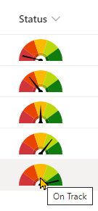
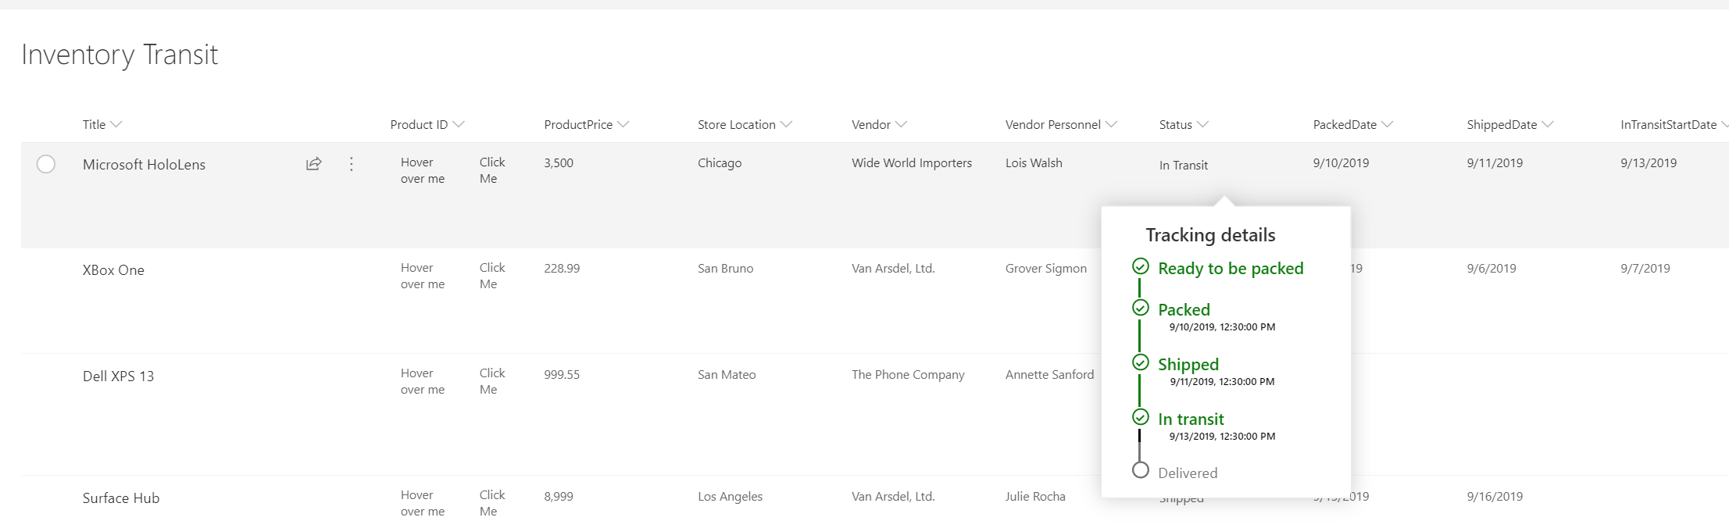
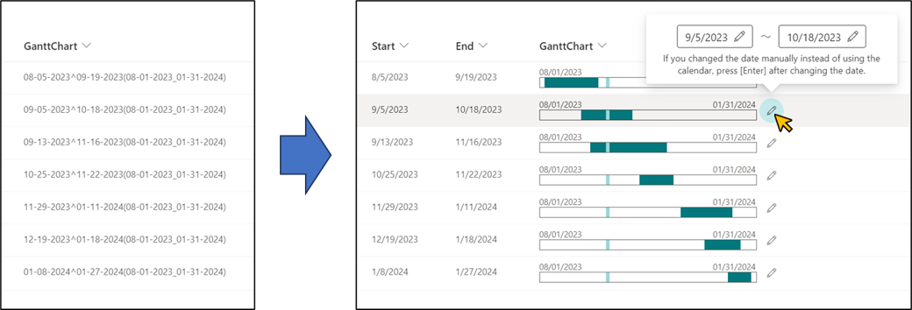
Column Samples: More Than Colored Pills
COLUMN
Custom Hover Card
Reveal richer context on hover
Generic Gantt Chart
Turn dates into a compact schedule visualization
Generic Gauge
Turn a number into an at-a-glance indicator
SharePoint in Depth • No-Code SharePoint Magic
9
Notes:
[Sources]
User-supplied screenshots: custom-hover-card.png; generic-gantt-chart.png; generic-gauge.png

Slide 10
View Formatting: Transform the Entire List
VIEWS
Microsoft Lists | Project Tracker
Title
Owner
Status
Due
Project A
Status • Owner
Project B
Status • Owner
Project A
Alex
In progress
Aug 12
Project B
Priya
Blocked
Aug 13
Project C
Status • Owner
Project D
Status • Owner
Project C
Jordan
Complete
Aug 14
• Same list. Completely different experience.
• Custom JSON code can change rows, tiles, layout, command behavior, grouping, and more.
SharePoint in Depth • No-Code SharePoint Magic
11

Slide 11
PnP View Samples: Business-Friendly Layouts
VIEWS
Bulletin Board
Turn list items into announcement-style notes
Contact Cards
Make people information scannable and visual
Custom Charts
Use list data to create visual summaries
Employee Onboarding
Process stages as a guided experience
Key Takeaway
Lists can become purpose-built experiences without SPFx or Power Apps.
SharePoint in Depth • No-Code SharePoint Magic
12

Slide 12
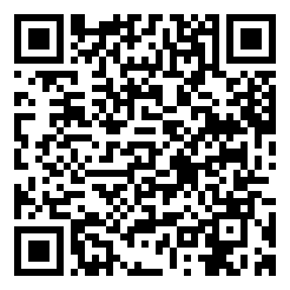
Take the Magic With You
PnP List Formatting Samples
Scan the QR code or open the repository to explore:
• Column samples
• Form samples
• View samples
Open GitHub Repository
Questions? • doug.spicer@dansolutions.com

